Slide 1

Deep Learning for Population Genetic Inference
by S. Sheehan, Y. Song
Farzan Farnia, Haitong Li, Ruishan Liu, Wanyi Qian, Fei Xia
10/31/16

Slide 2
Population Genetic
Studies genetics differences within and across populations
Addresses phenomena such as adaptation and population structure
Basic question: Identifying genes that have undergone selection

Slide 3
Natural Selection
A key mechanism of Evolution, underlying specific traits of each specie
How to find genes causing phenotypic variation in different species?
Classifying genome into Neutral vs. Selected regions via SVM,…

Slide 4
Demographic Factors
Variability in genome depends not only on selection but also on demography
How to address the demographic effects in identifying genes targeted by selection?
Methods robust against demographic changes
Joint-inference of selection and demography

Slide 5
Drosophila
Many population genetics studies on Drosophila
Both demography and selection has significant roles
Main focus of this paper

Slide 6
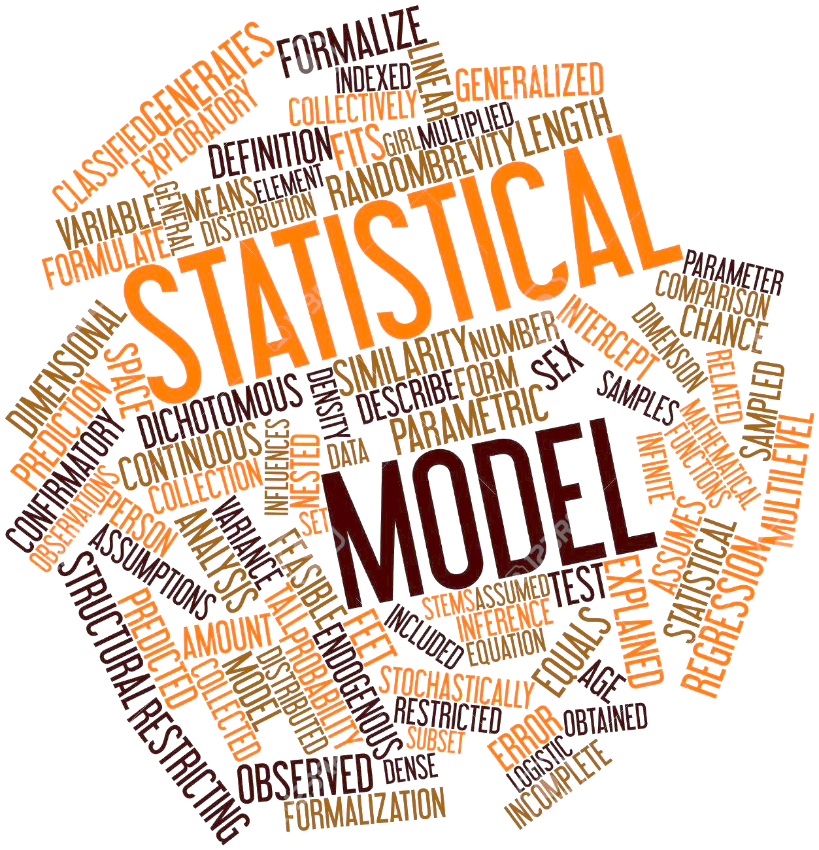
Model-based Approaches
Demography affects the entire genome, while selection is local
Use a parametrized model to incorporate demographic influences

Slide 7
Model-based Approaches
Demography affects the entire genome, while selection is local
Use a parametrized model to incorporate demographic influences
Computing the Likelihood for such complex models is infeasible!

Slide 8
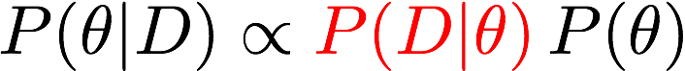
Approximate Bayesian Computation (ABC)

Slide 9
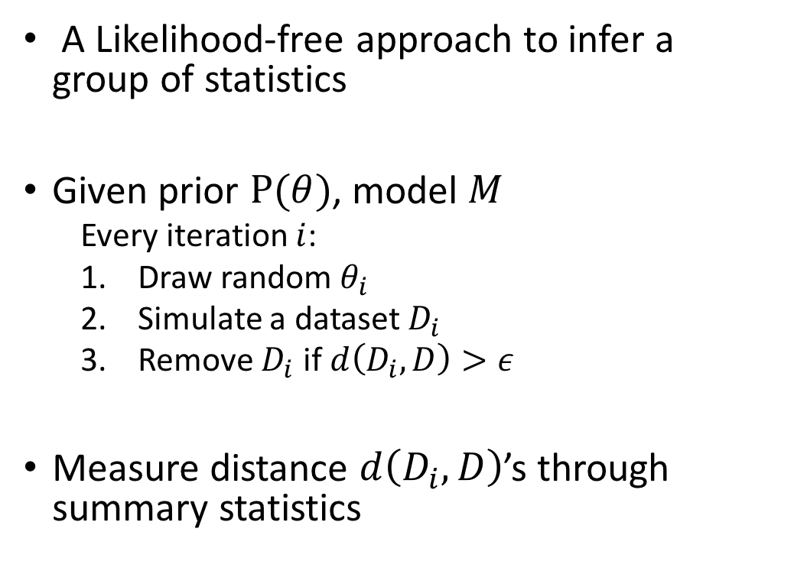
Approximate Bayesian Computation (ABC)
A Likelihood-free approach to infer a group of statistics
Given prior $P(θ)$, model $M$
Every iteration $i$:
Draw random $θ_{i}$
Simulate a dataset $D_{i}$
Remove $D_{i}$ if $d\left(D_{i},D\right)>ε$
Measure distance $d\left(D_{i},D\right)$’s through summary statistics

Slide 10
The Cons of ABC method
Accuracy and stability drops significantly by increasing the number of summary statistics
Rejects a large portion of simulated datasets
Lack of interpretability for the summary statistics

Slide 11
Model
Fully Connected NN
Multi-task learning: both continuous and categorical output
Weight initialization:
Random
Autoencoder Initialization
Implementation: Java
Hyper parameters:
#layers: 5
#input: 345
#output: 4
#nodes: 25,25,10
Activation function: Sigmoid
Activation function(Output layer):
Softmax(classification) and Linear(regression)
Notes:
Model: fully connected NN

Slide 12
Experiments
Simulation
3 effective populations, 4 selection classes
2500 demographic histories, 160 regions for each one, 100 haplotypes.
Uses software msms.
Summary statistics calculation
Tajima’s D statistic, Folded site frequency spectrum, Identity-by-state, Linkage disequilibrium, …
345 statistics in all
Model training and prediction
Model interpretation(permutation and perturbation tests)
Ewing, Gregory, and Joachim Hermisson. “MSMS: a coalescent simulation program including recombination, demographic structure and selection at a single locus.”
Bioinformatics 26.16 (2010): 2064-2065.

Slide 13
Performance on simulated and real data
Estimation of demographic history
Simulated data
Real data((Drosophila)
Notes:
Results of demographic estimation

Slide 14
Estimation of demographic history, compared with previous results
Consistent with PSMC results
Notes:
Results of demographic estimation

Slide 15
Estimation of selection type, on simulated data
True label: hard sweep
Notes:
Selection results, on simulated and real data.

Slide 16
Estimation of selection type, different initialization methods
Comments: They should find the reason：bad choice of initialization method? Saturation?
Glorot, Xavier, and Yoshua Bengio. "Understanding the difficulty of training deep feedforward neural networks." International conference on artificial intelligence and statistics. 2010.
Notes:
Results for different initialization

Slide 17
Model interpretation: importance of features
Notes:
Interpretation of model

Slide 18
Comparison with ABCToolbox
accuracy
Running time

Slide 19
Conclusions
Deep learning as an alternative for ABC approach.
Use all the summary statistics
Use all the datasets
Interpretable models
Estimate demographic history and selection type in one model.
Limitations:
Rely on model (3 demographic history phases)
Lack comparison with other models
Weird behavior when randomly initialize weights without explanation
Slow training (problem with implementation)
Questions?

